Slide 1
Programs & Programming
JC 01.1
(A. Nguyen)

Slide 2
What is a computer program or programming?
A program is a set of instructions that tell the computer to do a task; e.g., draw a red dot at a certain location on the screen, or total the prices of the items bought, etc.
The act of designing and writing programs is called programming. Using a computer does not require programming skills

Slide 3
The Anatomy of a Computer
JC 01.3
(A. Nguyen)

Slide 4
Computers
A computer in the early days used to take the space of a large room, with air-conditioning.
A computer now takes many forms that many of us are familiar with: desktops, laptops, tablets, smart phone, smart card, etc.
A computer’s main component is the motherboard, which holds parts of the computer like CPU & memory, and allows communication among them. It also provides connectors to peripherals.

Slide 5
The central processing unit
The central processing unit (CPU) is the heart of a computer
The CPU (such as Intel Core Processor) is composed of several hundred of million transistors
When a program is launched (e.g., when the user clicks on an icon), the CPU loads the program into memory (e.g., from the hard disk), and executes instructions, which likely involves fetching and processing of data such as arithmetic operations

Slide 6
Storage
Data in primary storage, also called memory or RAM (random-access memory), is kept intact only when there is power.
Data in secondary storage (such as hard disks or flash drives) persists even when there is no power.

Slide 7
Peripheral devices
These devices are to for interaction between people & computers.
Some examples of peripheral devices are keyboard, mouse, printer, speakers, etc.

Slide 8
The Java Programming Language
JC 01.3
(A. Nguyen)

Slide 9
About Java
Java is a high-level programming language, which is easy for humans to understand. A program in a high-level language is translated into machine code for computers to understand.
Java creator is James Gosling.
Java first gained its popularity when it was used in the form of applets, the Java code that could be run anywhere on the Internet, in mid 1990s.

Slide 10
Important benefits of Java
Safe: Java was designed to be used safely in browsers, so programs terminate if they try to do something unsafe
Portable: Java programs may be used, without changes, in various Operating Systems (such as Windows, UNIX, Linux, or Macintosh operating systems). This is possible because the Java compiler translates a Java program into machine code to be run by a program called the Java Virtual Machine (JVM), which simulates a CPU

Slide 11
Java for beginning students
It is rather involved to write even a simple Java program
There have been many versions of Java since official version 1 in 1997, now version 7
It is not possible to learn everything about Java in one course, especially with the very extensive Java Library – so be patient & continue to learn beyond this course

Slide 12
Development Environment
JC08-01.4
(A. Nguyen)

Slide 13
BlueJ
BlueJ is an integrated development environment (IDE) for Java. So is Eclipse.
It is “integrated” because it has all the tools in one place: the programmers can type (in the editor), compile, and run their programs.

Slide 14
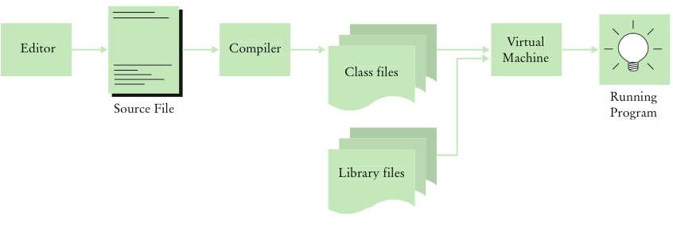
Becoming Familiar with Your Programming Environment
From Java Concepts, 8e, C. Horstmann
Figure 6 From Source Code to Running Program

Slide 15
Backing up
JC08 01.4
(A. Nguyen)

Slide 16
Why & how to back up
Back up your files so that you can go back to them if/when the file you are working on is (1) was accidentally deleted, or (2) is somehow corrupt, or (3) is totally messed up with the updates you just made.
Back up often, perhaps after each day/week.
Rotate your back-ups; for example, have one back-up for 1 day/week ago, one for 2 days/weeks ago, one for 3 days/weeks ago.
Be careful: replace the oldest back-up, not the other way around
Check you back-up once in a while to ascertain that the files are useable.

Slide 17
Class & its parts
JC08 01.
(A. Nguyen)

Slide 18
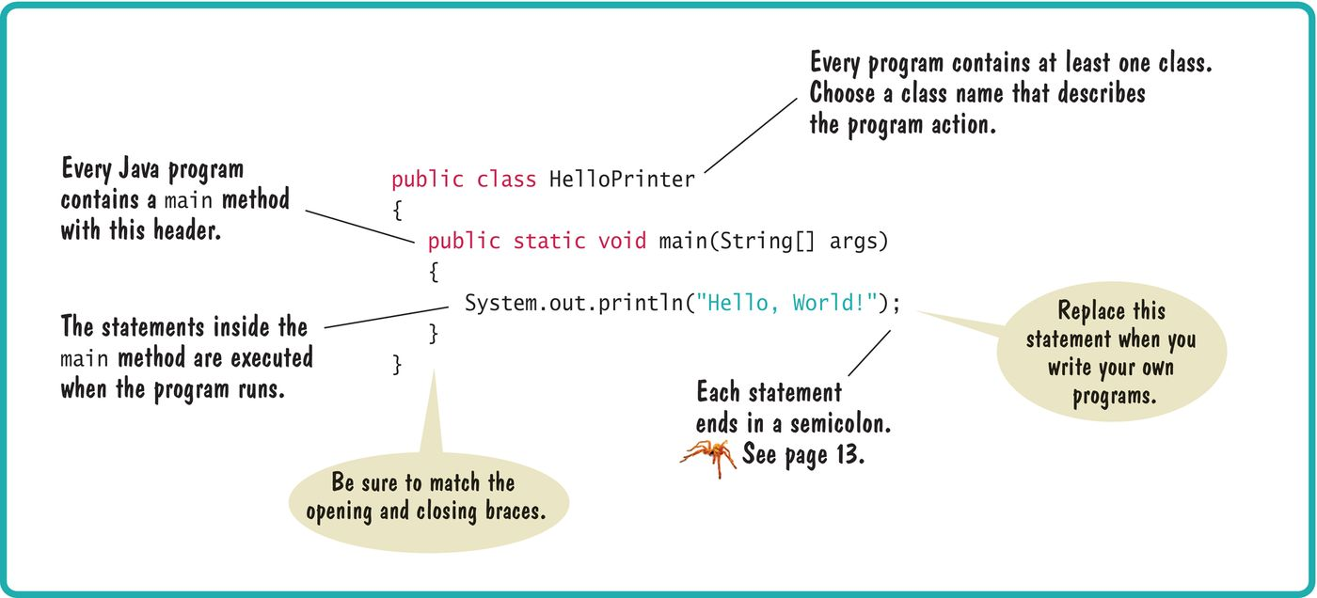
Syntax 1.1 Java Program
From Java Concepts, 8e, C. Horstmann

Slide 19
String
A Java String is a sequence of characters, expressed inside a pair of double quotes in Java
System.out.print or println expects one parameter/input, such as one String
If you have various pieces of text to be printed with 1 statement, you can concatenate them with + (i.e., plus sign). For example, if you have a person’s name in a variable called name, you can do:
System.out.println(“Hello, ” + name);
The plus sign is also used for addition, when there are 2 numeric operands; e.g., 3+4 will result in 7

Slide 20
Characters
A Java character may be typed with a key from the keyboard, or expressed as a hexadecimal value (see Unicode Table later)
A Java char is contained in single quotes – NOTE: String, in double quotes
Example: ‘A’

Slide 21
Characters (cont.)
Escape sequence is a character that, when typed with a key on the keyboard, will cause confusion in the Java syntax. Thus, it is expressed with a backslash: \t (tab), \n (new line), \” (double quotes).
Different ways to print blank line:
System.out.println(“”); // empty String
System.out.println(); // no parameter
System.out.println(“\n”); // “new line” escape seq.
System.out.println(“Hello, World\n”);
System.out.println(“He said \“hi\””);

Slide 22
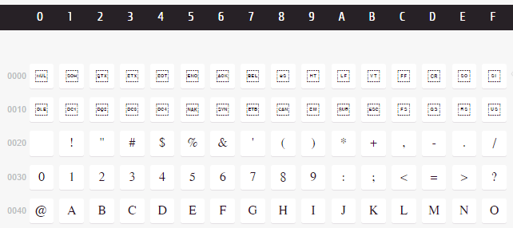
Unicode Table
To find a character/symbol, search for “unicode table” on the Internet:

Slide 23
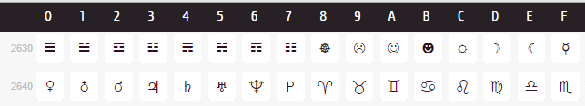
Unicode Table (cont.)
The very first column & the very first row (i.e., headers) identify the values of the characters – there are 65,536 possible characters
To identify a character/symbol, read the two values and add them; e.g., the value of the smiley = 2630 + A = 263A
Express the character in single quotes: ‘\u263A’

Slide 24
Unicode Table (cont.)
To print the character in Java:
System.out.print(‘\264A’);
Or
System.out.print(“Hello, World ” + ‘\264A’);
Note that the String “Hello, World ” (in double quotes) is first concatenated with the smiley character (in single quotes) for the smiley character, then the result is printed
The print statement expects a String, so when the value passed to it is not a String, it is converted to String automatically

Slide 25
Convention & Errors
JC08 01.6
(A. Nguyen)

Slide 26
Convention
Convention are “rules” used by programmers for other programmers
Always write comments to explain what you do in Java code, for yourself & fellow programmers
There are 3 ways to signal a comment:
Text within /** … */ is for documentation purpose understood Javac also
Text within /* … */ is for documentation purpose for a block of code, or to disable Java code
Text after // is for documentation purpose for one statement, or to disable one Java statement
Indent for each block – BlueJ does this automatically

Slide 27
Compile-time/syntax errors
Upper-cases and lower-cases are not interchangeable; e.g., totalCount and totalcount are two different variables
Reserved words must be spelled as-is; e.g., class is not Class
There must be a semi-colon at the end of each statement

Slide 28
Run-time/logic errors
If “Hello, Word” was accidentally typed (instead of “Hello, World” ), the compile would be successful and program would run. However, the result would not be the programmer’s intention. This is called run-time or logic error.
To avoid this kind of errors, the programs must be tested thoroughly, and different test cases considered. Even so, it is difficult to have 100% bug-free programs

Slide 29
Algorithms
JC08 01.6
(A. Nguyen)

Slide 30
About algorithms
An algorithm is a sequence of steps with 3 properties: unambiguous, executable, terminating
Pseudocode is a way to describe an algorithm in concise English, understood by humans but not computers
Pseudocode is the draft, to be used for coding later
The equal sign (=) in pseudocode & programming languages means “assigned to” or “gets”; it does NOT mean “equals to” like in math

Slide 31
THE END

